Slide 1
UNIVERSITY INSTITUTE OF ENGINEERING
COMPUTER SCIENCE ENGINEERING
Master of Engineering
ADVANCED DATA STRUCTURES
&
ALGORITHMS
(23CSH-622)
By : Dr. Ranjit Singh (E10947)
INTRODUCTION
DISCOVER . LEARN . EMPOWER

Slide 2
Contents of the Syllabus
UNIT-I (15h)
Introduction to Basic Data Structures: Importance and need of good data structures and algorithms, Introduction to linear and non-linear data structure and its importance, Algorithms Complexity and Analysis. [3]
Linear and Non –Linear Data Structures : Arrays , Link Lists, Queues , Trees and related algorithms [6]
Advanced Data Structures: AVL Trees (Insertion , Deletion , Searching), Red-Black Trees, B-trees, B+trees, Heaps. Data structure for disjoint sets, Augmented data structures. [6]
UNIT-II (15h)
Searching and Sorting : Internal and External Sorting algorithms: Linear Search, Binary Search, Bubble Sort, Selection Sort, Insertion Sort, Shell Sort, Quick Sort, Heap Sort, Merge Sort, Counting Sort, Radix Sort and analysis of their complexities and Hashing [4]
Graphs & Algorithms: Representation, Type of Graphs, Depth- and breadth-first traversals, Planar graphs, isomorphism, graph coloring, covering and partition, Minimum Spanning Tree: Prim’s and Kruskal’s algorithms. [6]
String Matching Algorithms: Naïve String Matching, Suffix arrays, Suffix trees, Rabin-Karp, Knuth-Morris-Pratt, Booyer-Moore algorithm [5]

Slide 3
Contents of the Syllabus
UNIT-III (15h)
Approximation algorithms: Need of approximation algorithms: Introduction to P, NP, NP-Hard and NP-Complete Greedy Approach, Dynamic Approach, Knapsack, Huffman Coding, TSP, All pair shortest path, Longest Common Subsequence Problem, Matrix Chain Multiplication. [7]
Randomized algorithms: Introduction, type of randomized algorithms, Quick sort, min cut [4]
Online Algorithms: Introduction, Online Paging Problem, k-server Problem. Data compression: Huffman’s coding, BWT, LZW [4]
Recommended Books:
1. Cormen, Leiserson, Rivest, Stein, “Introduction to Algorithms”, Prentice Hall of India, 3rd edition 2012.
2. Horowitz, Sahni and Rajasekaran, “Fundamental of Computer, Algorithms”, University Press (India), 2nd edition.
3. Aho, Haperoft and Ullman, “The Design and analysis of Computer Algorithms”, Pearson Education India.

Slide 4
Graph Isomorphism

Slide 5
Isomorphic Graphs
Graph Isomorphism is a phenomenon of existing the same graph in more than one forms. Such graphs are called as Isomorphic graphs.

Slide 6
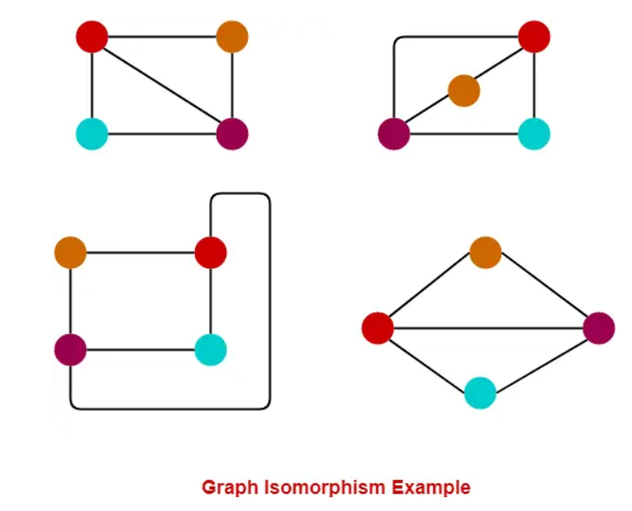

Slide 7
Isomorphism of Graphs
Definition: The simple graphs G₁ = (V₁, E₁) and G₂ = (V₂, E₂) are isomorphic if
there is a bijection (an one-to-one and onto function) f from V₁ to V₂ with the property that a and b are adjacent in G₁ if and only if f(a) and f(b) are adjacent in G₂, for all a and b in V₁.
Such a function f is called an isomorphism.
In other words, G₁ and G₂ are isomorphic if their vertices can be ordered in such a way that the adjacency matrices M_{G1} and M_{G2} are identical.

Slide 8
Isomorphism of Graphs
From a visual standpoint, G₁ and G₂ are isomorphic if they can be arranged in such a way that their displays are identical (of course without changing adjacency).

Slide 9
Isomorphism of Graphs
Example : Are the following two graphs isomorphic?
a
a
b
e
e
b
c
d
c
d
Solution: Yes, they are isomorphic, because they can be arranged to look identical. You can see this if in the right graph you move vertex b to the left of the edge {a, c}. Then the isomorphism f from the left to the right graph is: f(a) = e, f(b) = a, f(c) = b, f(d) = c, f(e) = d.

Slide 10
Isomorphism of Graphs
Unfortunately, for two simple graphs, each with n vertices, there are n! possible isomorphisms that we have to check in order to show that these graphs are isomorphic.
However, showing that two graphs are not isomorphic can be easy.

Slide 11
Isomorphism of Graphs: Necessary Conditions
For this purpose we can check invariants, that is, properties that two isomorphic simple graphs must both have.
For any two graphs to be isomorphic, following 4 conditions must be satisfied:
the same number of vertices,
the same number of edges, and
the same degrees of vertices.
If a cycle of length k is formed by the vertices { v₁ , v₂ , ….. , v_{k} } in one graph, then a cycle of same length k must be formed by the vertices { f(v₁) , f(v₂) , ….. , f(v_{k}) } in the other graph as well.
Note that two graphs that differ in any of these invariants are not isomorphic, but two graphs that match in all of them are not necessarily isomorphic.

Slide 12
Isomorphism of Graphs
Example : How about these two graphs?
a
a
b
e
e
b
c
c
d
d
Solution: No, they are not isomorphic, because they differ in the degrees of their vertices.
Vertex d in right graph is of degree one, but there is no such vertex in the left graph.

Slide 13
Isomorphism of Graphs: Sufficient Conditions
The following conditions are the sufficient conditions to prove any two graphs isomorphic.
If any one of these conditions satisfy, then it can be said that the graphs are surely isomorphic.
Two graphs are isomorphic if and only if their complement graphs are isomorphic.
Two graphs are isomorphic if their adjacency matrices are same.
Two graphs are isomorphic if their corresponding sub-graphs obtained by deleting some vertices of one graph and their corresponding images in the other graph are isomorphic.

Slide 14
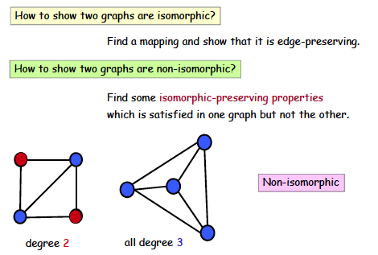
Graph isomorphism

Slide 15
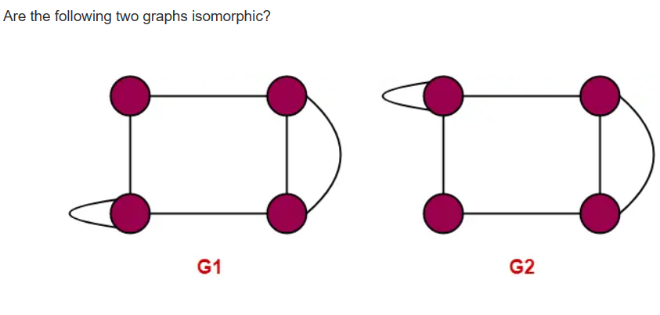

Slide 16
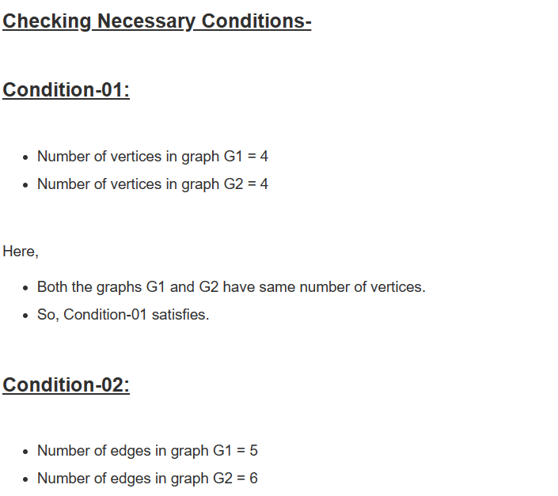
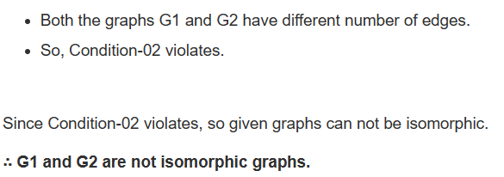

Slide 17
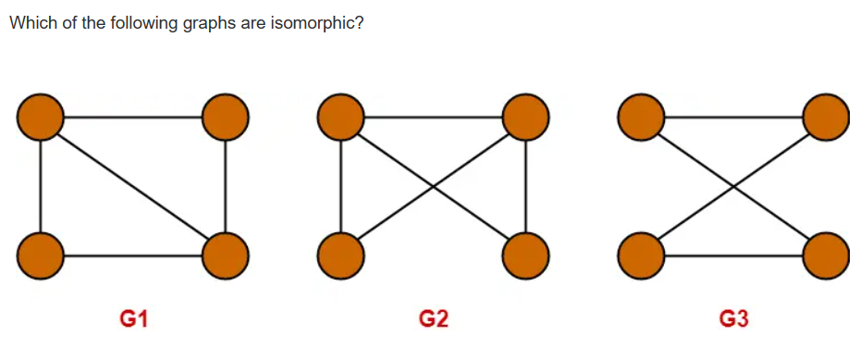

Slide 18
Example
Are these two graphs isomorphic?
u₁ u₂
u₅ u₃
u₄
v₁ v₂
v₅
v₃
v₄
G H
They both have 5 vertices
They both have 8 edges
They have the same number of vertices with the same degrees: 2, 3, 3, 4, 4.

Slide 19
Example (Cont.)
G H H → G?
u₁ u₂ u₃ u₄ u₅
u₁ 0 1 0 1 1
u₂ 1 0 1 1 1
u₃ 0 1 0 1 0
u₄ 1 1 1 0 1
u₅ 1 1 0 1 0
v₁ v₂ v₃ v₄ v₅
v₁ 0 0 1 1 1
v₂ 0 0 1 0 1
v₃ 1 1 0 1 1
v₄ 1 0 1 0 1
v₅ 1 1 1 1 0
v₁ v₃ v₂ v₅ v₄
v₁
v₃
v₂
v₅
v₄
G and H don’t appear to be isomorphic.
However, we haven’t tried mapping vertices from G onto H yet.

Slide 20
Example (Cont.)
Start with the vertices of degree 2 since each graph only has one:
deg(u₃) = deg(v₂) = 2 therefore f(u₃) = v₂

Slide 21
Example (Cont.)
Now consider vertices of degree 3
deg(u₁) = deg(u₅) = deg(v₁) = deg(v₄) = 3
therefore we must have either one of
f(u₁) = v₁ and f(u₅) = v₄
f(u₁) = v₄ and f(u₅) = v₁

Slide 22
Example (Cont.)
Now try vertices of degree 4:
deg(u₂) = deg(u₄) = deg(v₃) = deg(v₅) = 4
therefore we must have one of:
f(u₂) = v₃ and f(u₄) = v₅ or
f(u₂) = v₅ and f(u₄) = v₃

Slide 23
Example (Cont.)
There are four possibilities (this can get messy!)
f(u₁) = v₁, f(u₂) = v₃, f(u₃) = v₂, f(u₄) = v₅, f(u₅) = v₄
f(u₁) = v₄, f(u₂) = v₃, f(u₃) = v₂, f(u₄) = v₅, f(u₅) = v₁
f(u₁) = v₁, f(u₂) = v₅, f(u₃) = v₂, f(u₄) = v₃, f(u₅) = v₄
f(u₁) = v₄, f(u₂) = v₅, f(u₃) = v₂, f(u₄) = v₃, f(u₅) = v₁

Slide 24
Example (Cont.)
G H H’
u₁ u₂ u₃ u₄ u₅
u₁ 0 1 0 1 1
u₂ 1 0 1 1 1
u₃ 0 1 0 1 0
u₄ 1 1 1 0 1
u₅ 1 1 0 1 0
v₁ v₂ v₃ v₄ v₅
v₁ 0 0 1 1 1
v₂ 0 0 1 0 1
v₃ 1 1 0 1 1
v₄ 1 0 1 0 1
v₅ 1 1 1 1 0
v₁ v₃ v₂ v₅ v₄
v₁ 0 1 0 1 1
v₃ 1 0 1 1 1
v₂ 0 1 0 1 0
v₅ 1 1 1 0 1
v₄ 1 1 0 1 0
We permute the adjacency matrix of H (per function choices above) to see if we get the adjacency of G. Let’s try:
f(u₁) = v₁, f(u₂) = v₃, f(u₃) = v₂, f(u₄) = v₅, f(u₅) = v₄
Does G = H’? Yes!

Slide 25
Example (Cont.)
G H H’
u₁ u₂ u₃ u₄ u₅
u₁ 0 1 0 1 1
u₂ 1 0 1 1 1
u₃ 0 1 0 1 0
u₄ 1 1 1 0 1
u₅ 1 1 0 1 0
v₁ v₂ v₃ v₄ v₅
v₁ 0 0 1 1 1
v₂ 0 0 1 0 1
v₃ 1 1 0 1 1
v₄ 1 0 1 0 1
v₅ 1 1 1 1 0
v₄ v₃ v₂ v₅ v₁
v₄ 0 1 0 1 1
v₃ 1 0 1 1 1
v₂ 0 1 0 1 0
v₅ 1 1 1 0 1
v₁ 1 1 0 1 0
It turns out that
f(u₁) = v₄, f(u₂) = v₃, f(u₃) = v₂, f(u₄) = v₅, f(u₅) = v₁
also works.

Slide 26
Graph Covering

Slide 27

Vertex Cover
A vertex-cover of an undirected graph G=(V,E) is a subset V’ of V such that
if edge (u, v) is an edge of G, then u is in V’, or v is in V’, or both. The set
V′ is said to "cover" the edges of G
Minimal or minimum vertex cover is a famous problem in graph theory

Slide 28
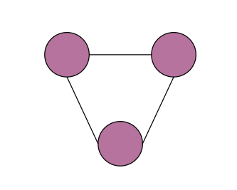
Vertex Cover of the Graph ?

Slide 29
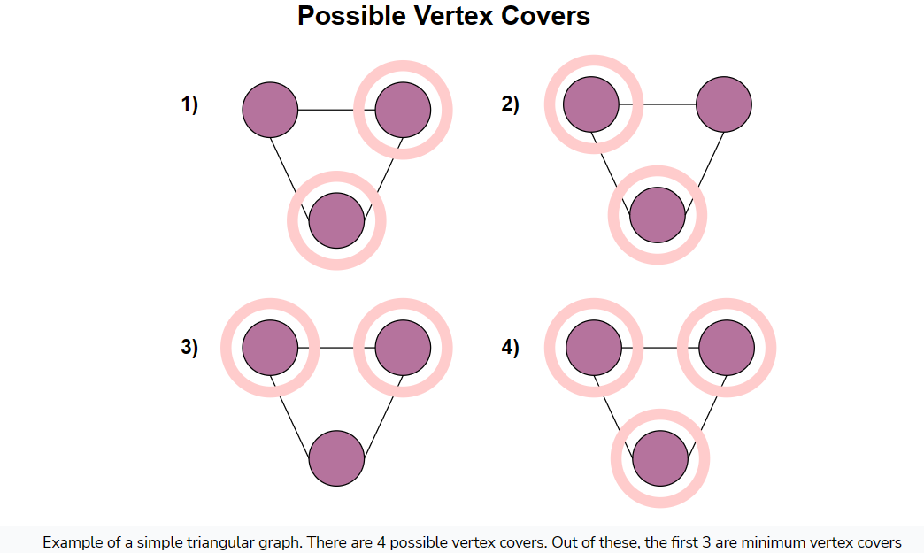

Slide 30
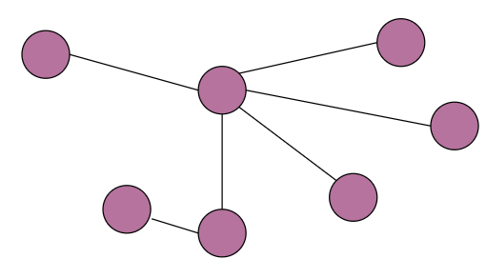
Vertex Cover of the Graph ?

Slide 31
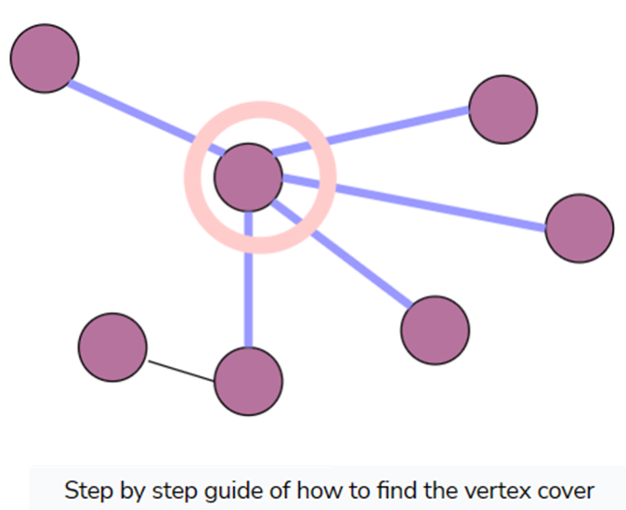

Slide 32
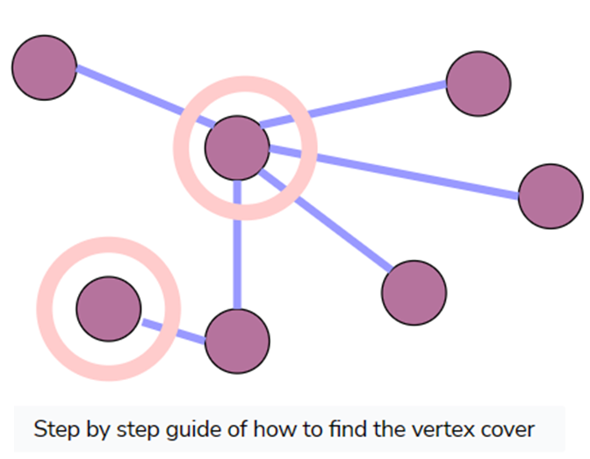

Slide 33
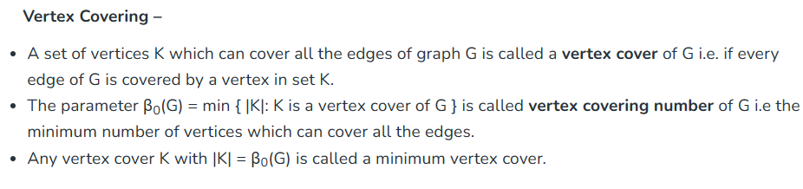

Slide 34
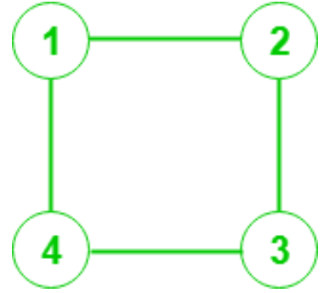
Vertex Cover of the Graph ?

Slide 35
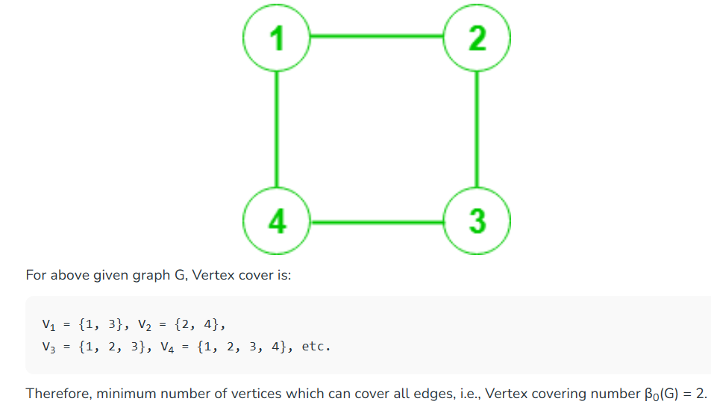

Slide 36
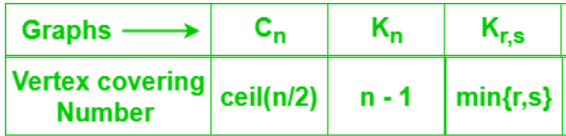
Vertex Covering Number

Slide 37
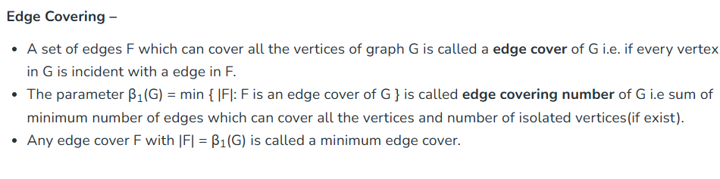

Slide 38
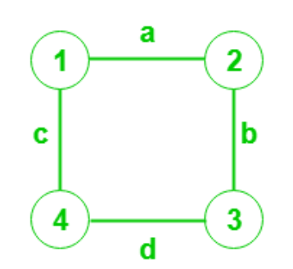
Edge Cover of the Graph ?

Slide 39
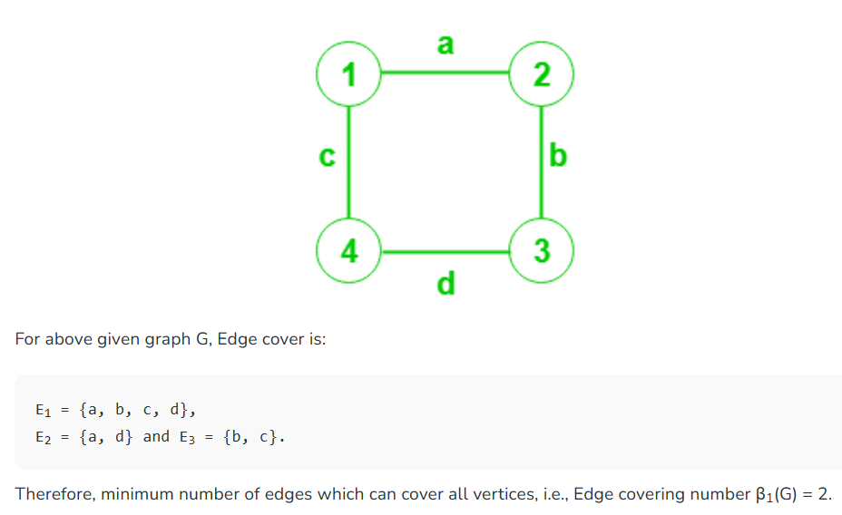
Edge covering of graph G with n vertices has at least n/2 edges.

Slide 40
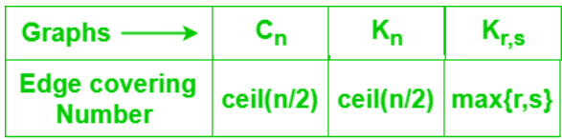
Edge/Line Covering Number

Slide 41
Graph Partition

Slide 42
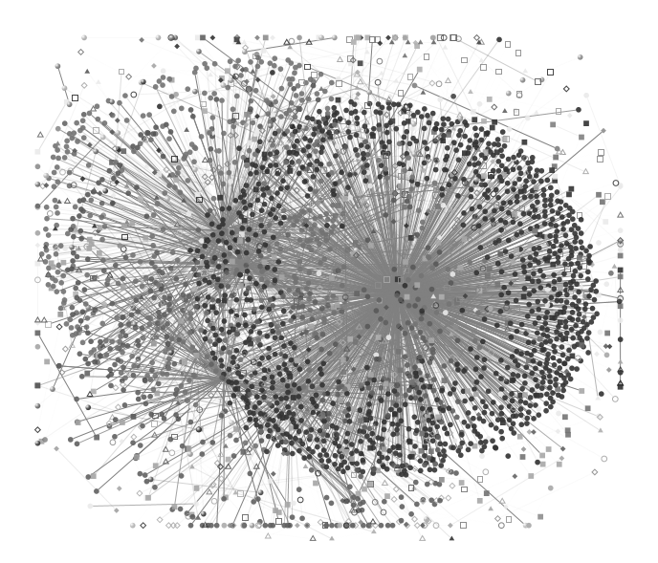
Introduction
The undirected large graph
E.g) Social graph
A sampled user email-connectivity graph : http://research.microsoft.com/en-us/projects/S-GPS/

Slide 43

Introduction
The undirected large graph
E.g) Social graph
Q : What does this large graph present?
A sampled user email-connectivity graph : http://research.microsoft.com/en-us/projects/S-GPS/

Slide 44
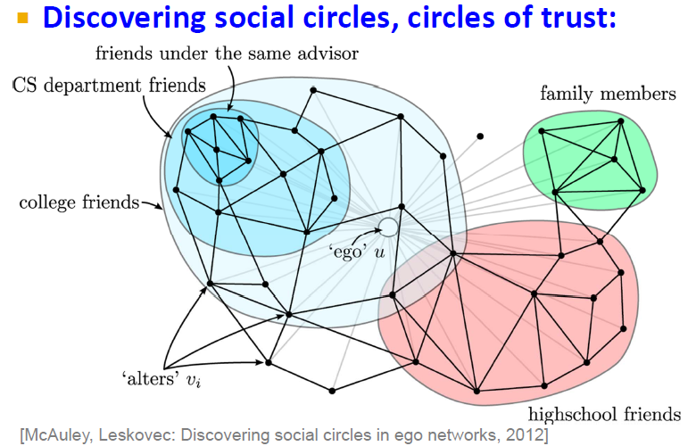
Motivation
If we can partition, we can use it for analysis of graph as below

Slide 45
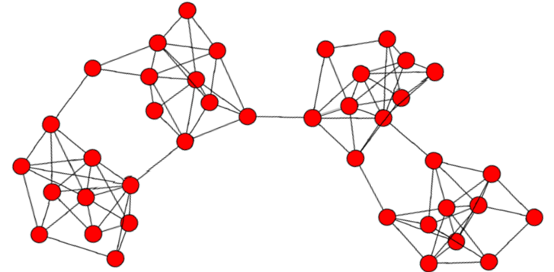
Motivation
Graph partition & community detection

Slide 46
Motivation
Graph partition & community detection

Slide 47
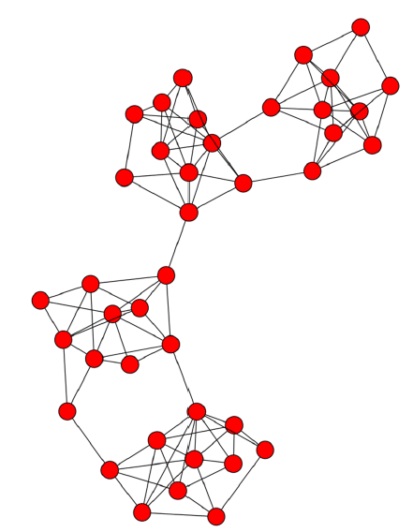
Motivation
Graph partition & community detection
Partition
Community

Slide 48

Motivation
Graph partition & community detection
Partition
Community
Q : How can we find the partitions?

Slide 49
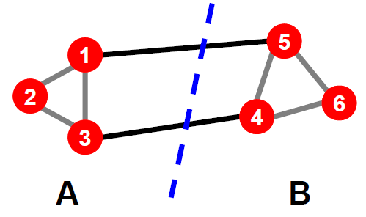
Criterion : Basic principle
Graph partitioning : A & B
A Basic principle for graph partitioning
Minimize the number of between-group connections
Maximize the number of within-group connections

Slide 50
Criterion : Graph partitioning
1. Minimum-cut
2. Normalized-cut

Slide 51
Criterion: Min-cut?
Min-cut carves out small isolated parts of the graph
In image segmentation: individual pixels

Slide 52
Min-cut
“Cut” = total weight of cut edges
Small cut means the groups don’t “like” each other
“Volume” of a subgraph = total weight of edges within the subgraph

Slide 53

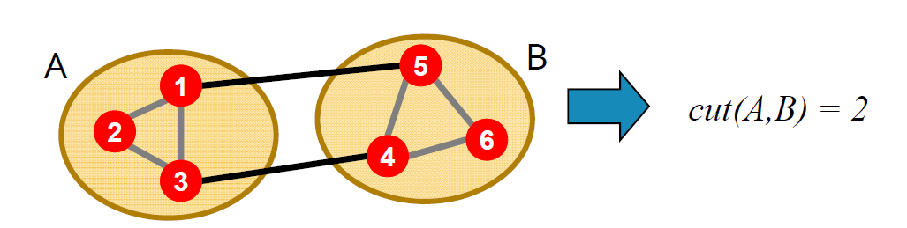
Mathematical expression : Cut (A,B)
For considering between-group

Slide 54

Mathematical expression : Vol (A)
For considering within-group
vol (A) = 5
vol (B) = 5

Slide 55
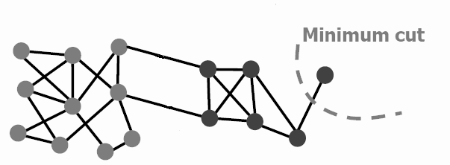
Criterion : Min-cut
Minimize the number of between-group connections
minA,B cut(A,B)
A
B
Cut(A,B) = 1 -> Minimum value

Slide 56
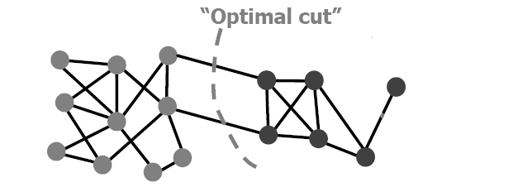
Criterion : Min-cut
A
B
Cut(A,B) = 1
A
But, it looks more balanced…
How?
B

Slide 57
Normalized cuts
“Cut” = total weight of cut edges
Small cut means the groups don’t “like” each other
But need to normalize w.r.t how much they like themselves
“Volume” of a subgraph = total weight of edges within the subgraph

Slide 58
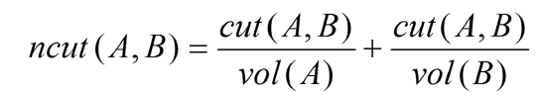
Criterion : N-cut
Minimize the number of between-group connections
Maximize the number of within-group connections
If we define ncut(A,B) as below,
-> The minimum value of ncut(A,B) will produces more balanced partitions because it consider both principles

Slide 59
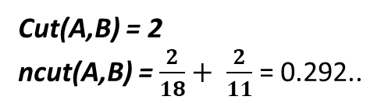
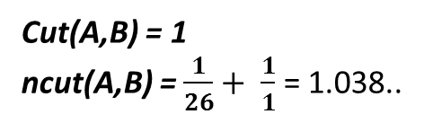
Methodology
A
B
Cut(A,B) = 1
ncut(A,B) = $\frac{1}{26}+ \frac{1}{1}$ = 1.038..
VS
A
B
Cut(A,B) = 2
ncut(A,B) = $\frac{2}{18}+ \frac{2}{11}$ = 0.292..

Slide 60
Criterion : Min-cut VS N-cut
A Basic principle for graph partitioning
Minimize the number of between-group connections
Maximize the number of within-group connections
Minimum-Cut vs Normalized-Cut
 | Min-cut | N-cut
Minimize: between group connections
Maximize : within-group connections | X

Slide 61
Spanning Trees

Slide 62
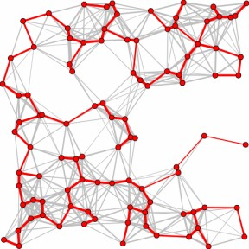
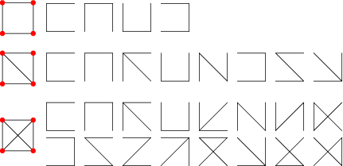
spanning trees
A spanning tree of a connected graph G is a subgraph of G which contains all the vertices in G and is a tree.

Slide 63
computing spanning trees using graph traversal
dfs-spanning-tree() :
T is an empty tree
add v to T
visit(v)
visit(v):
for every neighbor w of v :
if w is not in T :
add w and {v, w} to T
visit(w)
A spanning tree can be computed by a variation on DFS:
can also be computed using BFS.

Slide 64
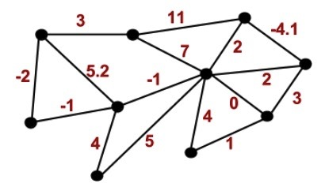
weighted graphs
A weighted graph is a graph G = (V ,E), along with a function
w: E → R. The function w assigns a real number to every edge.

Slide 65
minimum spanning trees
Motivating example: each house in the neighborhood needs to be connected to cable
Graph where each house is a vertex.
Need the graph to be connected, and minimize the cost of laying the cables.
Model the problem with weighted graphs
Minimum spanning tree
Spanning tree minimizing the sum of edge weights
Incrementally build spanning tree by adding the least-cost edge to the tree
A
4
B
3
C
2

Slide 66
Minimum Spanning Tree
Minimum-cost spanning trees have many applications.
Building cable networks that join n locations with minimum cost.
Building a road network that joins n cities with minimum cost.
Obtaining an independent set of circuit equations for an electrical network.
In pattern recognition minimal spanning trees can be used to find noisy pixels.

Slide 67
Wiring: Better Approach
Central office
Minimize the total length of wire connecting the customers

Slide 68
Minimum Spanning Tree
Brute Force option:
For all possible spanning trees
Calculate the sum of the edge weights
Keep track of the tree with the minimum weight.
Step i) requires N-1 time, since each tree will have exactly N-1 edges.
If there are M spanning trees, then the total cost will O(MN).
Consider a complete graph, with N(N-1) edges. How big can M be?

Slide 69
Brute Force MST
For a complete graph, it has been shown that there are N^{N-2} possible spanning trees!
Alternatively, given N items, you can build N^{N-2} distinct trees to connect these items.
Note, for a lattice (like your grid implementation), the number of spanning trees is O(e^{1.167N}).

Slide 70
Minimum Spanning Tree
There are many approaches to computing a minimum spanning tree. We could try to detect cycles and remove edges, but the two algorithms we will study build them from the bottom-up in a greedy fashion.
Kruskal’s Algorithm – starts with a forest of single node trees and then adds the edge with the minimum weight to connect two components.
Prim’s Algorithm – starts with a single vertex and then adds the minimum edge to extend the spanning tree.

Slide 71
Kruskal’s Algorithm
Greedy algorithm to choose the edges as follows.
Step 1 | First edge: choose any edge with the minimum weight.
Step 2 | Next edge: choose any edge with minimum weight from those not yet selected. (The subgraph can look disconnected at this stage.)
Step 3 | Continue to choose edges of minimum weight from those not yet selected, except do not select any edge that creates a cycle in the subgraph.
Step 4 | Repeat step 3 until the subgraph connects all vertices of the original graph.

Slide 72
Kruskal Example
2704
867
BOS
849
PVD
ORD
187
740
144
1846
621
JFK
184
1258
802
SFO
BWI
1391
1464
337
1090
DFW
946
LAX
1235
1121
MIA
2342

Slide 73
Example

Slide 74
Example

Slide 75
Example

Slide 76
Example

Slide 77
Example

Slide 78
Example

Slide 79
Example

Slide 80
Example

Slide 81
Example

Slide 82
Example

Slide 83
Example

Slide 84
Example

Slide 85
Example
2704
867
BOS
849
PVD
ORD
187
740
144
1846
621
JFK
184
1258
802
SFO
BWI
1391
1464
337
1090
DFW
946
LAX
1235
1121
MIA
2342

Slide 86
Kruskal’s Algorithm
Build a priority queue (min-based) with all of the edges of G.
T = φ ;
while(queue is not empty){
get minimum edge e from priorityQueue;
if(e does not create a cycle with edges in T)
add e to T;
}
return T;

Slide 87
Kruskal’s Algorithm – Time complexity
Steps
Initialize forest O( |V| )
Sort edges O( |E|log|E| )
Check edge for cycles O( |V| ) x
Number of edges O( |V| ) O( |V|² )
Total O( |V|+|E|log|E|+|V|² )
Since |E| = O( |V|² ) O( |V|² log|V| )
Thus we would class MST as O( n² log n ) for a graph with n vertices
This is an upper bound, some improvements on this are known.

Slide 88
Kruskal’s Algorithm
2
19
9
14
17
8
25
5
21
13
1

Slide 89
Kruskal’s Algorithm
2
19
9
14
17
8
25
5
21
13
1?
1

Slide 90
Kruskal’s Algorithm
2
19
9
14
17
8
25
5
21
13
1?
1

Slide 91
Kruskal’s Algorithm
2
19
9
14
17
8
25
5
21
13
1?
1

Slide 92
Kruskal’s Algorithm
2
19
9
14
17
8
25
5
21
13
1?
1

Slide 93
Kruskal’s Algorithm
2
19
9
14
17
8
25
5
21
13
1?
1

Slide 94
Kruskal’s Algorithm
2
19
9
14
17
8
25
5
21
13
1?
1

Slide 95
Kruskal’s Algorithm
2
19
9
14
17
8
25
5
21
13
1?
1

Slide 96
Prim’s Algorithm
Prim’s algorithm finds a minimum cost spanning tree by selecting edges from the graph one-by-one as follows:
It starts with a tree, T, consisting of a single starting vertex, x.
Then, it finds the shortest edge emanating from x that connects T to the rest of the graph (i.e., a vertex not in the tree T).
It adds this edge and the new vertex to the tree T.
It then picks the shortest edge emanating from the revised tree T that also connects T to the rest of the graph and repeats the process.

Slide 97
Prim’s Algorithm Abstract
Consider a graph G=(V, E);
Let T be a tree consisting of only the starting vertex x;
while (T has fewer than I V I vertices)
{
find a smallest edge connecting T to G-T;
add it to T;
}

Slide 98
Prim’s Algorithm
2
19
9
14
17
Start here
8
25
5
21
13
1

Slide 99
Prim’s Algorithm
2
19
9
14
17
8
25
5
21
13
1?
1

Slide 100
Prim’s Algorithm
2
19
9
14
17
8
25
5
21
13
1

Slide 101
Prim’s Algorithm
2
19
9
14
17
8
25
5
21
13
1

Slide 102
Prim’s Algorithm
2
19
9
14
17
8
25
5
21
13
1

Slide 103
Prim’s Algorithm
2
19
9
14
17
8
25
5
21
13
1

Slide 104
Prim’s Algorithm
2
19
9
14
17
8
25
5
21
13
1

Slide 105
Prim’s Algorithm
2
19
9
14
17
8
25
5
21
13
1

Slide 106
A cable company want to connect five villages to their network which currently extends to the market town of Avenford. What is the minimum length of cable needed?
Prim’s algorithm with an Adjacency Matrix
Brinleigh
5
Cornwell
3
4
8
6
8
Avenford
Fingley
Donster
7
5
4
2
Edan

Slide 107
Prim’s algorithm with an Adjacency Matrix
Note, this example has outgoing edges on the columns and incoming on the rows, so it is the transpose of adjacency matrix mentioned in class. Actually, it is an undirected, so A^{T} = A.
 | A | B | C | D | E | F
A | - | 3 | - | - | 4 | 7
B | 3 | - | 5 | - | - | 8
C | - | 5 | - | 4 | - | 6
D | - | - | 4 | - | 2 | 8
E | 4 | - | - | 2 | - | 5
F | 7 | 8 | 6 | 8 | 5 | -

Slide 108
1
 | A | B | C | D | E | F
A | - | 3 | - | - | 4 | 7
B | 3 | - | 5 | - | - | 8
C | - | 5 | - | 4 | - | 6
D | - | - | 4 | - | 2 | 8
E | 4 | - | - | 2 | - | 5
F | 7 | 8 | 6 | 8 | 5 | -
Start at vertex A. Label column A “1” .
Delete row A
Select the smallest entry in column A (AB, length 3)
Brinleigh
3
Avenford

Slide 109
1
2
 | A | B | C | D | E | F
A | - | 3 | - | - | 4 | 7
B | 3 | - | 5 | - | - | 8
C | - | 5 | - | 4 | - | 6
D | - | - | 4 | - | 2 | 8
E | 4 | - | - | 2 | - | 5
F | 7 | 8 | 6 | 8 | 5 | -
Label column B “2”
Delete row B
Select the smallest uncovered entry in either column A or column B (AE, length 4)
Brinleigh
3
Avenford
4
Edan

Slide 110
1
2
3
 | A | B | C | D | E | F
A | - | 3 | - | - | 4 | 7
B | 3 | - | 5 | - | - | 8
C | - | 5 | - | 4 | - | 6
D | - | - | 4 | - | 2 | 8
E | 4 | - | - | 2 | - | 5
F | 7 | 8 | 6 | 8 | 5 | -
Label column E “3”
Delete row E
Select the smallest uncovered entry in either column A, B or E (ED, length 2)
Brinleigh
3
Avenford
Donster
4
2
Edan

Slide 111
1
2
4
3
 | A | B | C | D | E | F
A | - | 3 | - | - | 4 | 7
B | 3 | - | 5 | - | - | 8
C | - | 5 | - | 4 | - | 6
D | - | - | 4 | - | 2 | 8
E | 4 | - | - | 2 | - | 5
F | 7 | 8 | 6 | 8 | 5 | -
Label column D “4”
Delete row D
Select the smallest uncovered entry in either column A, B, D or E (DC, length 4)
Cornwell
Brinleigh
3
4
Avenford
Donster
4
2
Edan

Slide 112
1
2
5
4
3
 | A | B | C | D | E | F
A | - | 3 | - | - | 4 | 7
B | 3 | - | 5 | - | - | 8
C | - | 5 | - | 4 | - | 6
D | - | - | 4 | - | 2 | 8
E | 4 | - | - | 2 | - | 5
F | 7 | 8 | 6 | 8 | 5 | -
Label column C “5”
Delete row C
Select the smallest uncovered entry in either column A, B, D, E or C (EF, length 5)
Cornwell
Brinleigh
3
4
Fingley
Avenford
5
Donster
4
2
Edan

Slide 113
1
2
5
4
3
6
FINALLY
Label column F “6”
Delete row F
 | A | B | C | D | E | F
A | - | 3 | - | - | 4 | 7
B | 3 | - | 5 | - | - | 8
C | - | 5 | - | 4 | - | 6
D | - | - | 4 | - | 2 | 8
E | 4 | - | - | 2 | - | 5
F | 7 | 8 | 6 | 8 | 5 | -
Cornwell
Brinleigh
3
4
Fingley
Avenford
5
Donster
4
2
Edan

Slide 114
1
2
5
4
3
6
FINALLY
Label column F “6”
Delete row F
 | A | B | C | D | E | F
A | - | 3 | - | - | 4 | 7
B | 3 | - | 5 | - | - | 8
C | - | 5 | - | 4 | - | 6
D | - | - | 4 | - | 2 | 8
E | 4 | - | - | 2 | - | 5
F | 7 | 8 | 6 | 8 | 5 | -
Cornwell
Brinleigh
3
4
Fingley
Avenford
5
Donster
4
2
The spanning tree is shown in the diagram
Length 3 + 4 + 4 + 2 + 5 = 18Km
Edan

Slide 115
Prim’s Algorithm
Initialization
a. Pick a vertex r to be the root
b. Set D(r) = 0, parent(r) = null
c. For all vertices v ∈ V, v ≠ r, set D(v) = ∞
d. Insert all vertices into priority queue P,
using distances as the keys
9
Vertex Parent
e -
b
a
2
6
e
a
b
c
d
d
4
5
0
∞
∞
∞
∞
5
4
5
e
c

Slide 116
Prim’s Algorithm
While P is not empty:
1. Select the next vertex u to add to the tree
u = P.deleteMin()
2. Update the weight of each vertex w adjacent to u which is not in the tree (i.e., w ∈ P)
If weight(u,w) < D(w),
a. parent(w) = u
b. D(w) = weight(u,w)
c. Update the priority queue to reflect
new distance for w

Slide 117
Prim’s algorithm
Vertex Parent
e -
b -
c -
d -
e
d
b
c
a
0
∞
∞
∞
∞
9
b
a
2
6
d
4
5
Vertex Parent
e -
b e
c e
d e
5
4
d
b
c
a
5
e
c
4
5
5
∞
The MST initially consists of the vertex e, and we update
the distances and parent for its adjacent vertices

Slide 118
Prim’s algorithm
Vertex Parent
e -
b e
c e
d e
d
b
c
a
4
5
5
∞
9
b
a
2
6
d
4
5
5
4
Vertex Parent
e -
b e
c d
d e
a d
5
e
c
a
c
b
2
4
5

Slide 119
Prim’s algorithm
Vertex Parent
e -
b e
c d
d e
a d
a
c
b
2
4
5
9
b
a
2
6
d
4
5
5
4
5
e
c
Vertex Parent
e -
b e
c d
d e
a d
c
b
4
5

Slide 120
Prim’s algorithm
Vertex Parent
e -
b e
c d
d e
a d
c
b
9
b
4
5
a
2
6
d
4
5
5
4
5
e
Vertex Parent
e -
b e
c d
d e
a d
c
b
5

Slide 121
Prim’s algorithm
Vertex Parent
e -
b e
c d
d e
a d
b
5
9
b
a
2
6
d
4
5
5
4
5
e
c
Vertex Parent
e -
b e
c d
d e
a d
The final minimum spanning tree

Slide 122
Prim’s algorithm assumes that all vertices are connected. But in a directed graph, every node is not reachable from every other node. So, Prim’s algorithm fails due to this reason.
The time complexity of the Prim’s Algorithm is O((V+E)logV) because each vertex is inserted in the min heap (priority queue) only once and insertion in heap take logarithmic time.
For kruskal’s algorithm the edges are maintained as min heap. The next edge can be obtained in O(logE) time if graph has E edges. Reconstruction of heap takes O(E) time. So, Kruskal’s Algorithm takes O(ElogE) time.

Slide 123
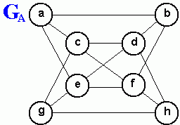
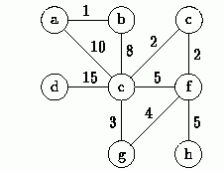
Practice
G_{B}
Find the breadth-first spanning tree and depth-first spanning tree of the graph GA shown above.
For the graph GB shown above, trace the execution of Prim's algorithm as it finds the minimum-cost spanning tree of the graph starting from vertex a.
Repeat question 2 above using Kruskal's algorithm.

Slide 124
Why prim’s algorithm is best for dense graph whereas kruskal’s algorithm is best for sparse graph???????????

Slide 125
Will prim’s and Kruskal’s algorithm work for directed graph?

Slide 126
Why prim’s and Kruskal’s algorithm not work for directed graph?
In Kruskal’s algorithm, In each step, it is checked that if the edges form a cycle with the spanning-tree formed so far.
But Kruskal’s algorithm fails to detect the cycles in a directed graph as there are cases when there is no cycle between the vertices but Kruskal’s Algorithm assumes it to cycle and don’t take consider some edges due to which Kruskal’s Algorithm fails for directed graph.

Slide 127
That’s All

